Slide 1
Parallel Programming with Futures and Isolates
Arrays of Futures
Morten Kromberg, Dyalog Ltd.

Slide 2
Agenda
Review the parallel language features of APL
Explain why they do not achieve our goal:
To put parallel hardware at the fingertips of domain experts
Attempt to explain how we arrived at the proposed solution with live demos
Talk about the ”To Do List”

Slide 3
3-Minute APL Refresher
Live Code 1...
For more, search on YouTube for ”Google Talks Dyalog”
Big Thank You to Ryan Lemmer for feedback on my #FnConf14 Talk!
Syntactical Form | Example | Result
array | 1 3.1415 1.2E18
function argument | ⍳ 6 | 1 2 3 4 5 6
left-arg function right-arg | 1 2 3 × 1 10 100 | 1 20 300
operand operator | ×/ 1 2 3 4 5 6 2 +/ 1 2 3 4 5 6 | 720 3 5 7 9 11
left-op operator right-op | 1 0 2 +.× 1 2 3 | 7
array[indices] | 'ABCDEF'[2 5 5 6] | BEEF

Slide 4






APL is a Parallel Notation
Example 1: Outer / Cartesian Product
Vec1 ∘.x Vec2
1 | 2
10 | 100 | 1000

Slide 5



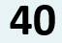


APL is a Parallel Notation
Example 2: Rank operator
Mat (x⍤1) Vec
1 | 2 | 3
4 | 5 | 6
10 | 100 | 1000

Slide 6
Review of Parallel Forms in APL
Parallel Forms
f (map often implicit)
f¨ (each: explicit map)
f⍤n (rank: map sub-arrays)
f.g (inner product)
f⌸ (key: ”group by”)
Sometimes Parallelizable Forms
f/ (reduction)
f\ (scan)
f⍣n (apply n times or until fixpoint)

Slide 7
Asynchronous Language Features
Dyalog has supported threads for a couple of decades via the ”spawn” operator &:
threadId ← (foo &) args ⍝ Run foo in own thread
result ← ⎕TSYNC threadId ⍝ Collect result
We have critical sections: :Hold 'resource' … blah blah … :EndHold
And latches and semaphores via a ”token pool”: ⎕TPUT / ⎕TGET

Slide 8


Asynchronous Language Features
Drink Tea and Carry On…?
No: existing threading is timeslicing a single OS thread. Interpreter core is 30+ years old and not thread safe.
Worse:
Threads-and-locks programming is hard
Paul Butcher, Seven Concurrency Models in Seven Weeks
If it is hard (and untestable) for real software engineers, what does this mean for our ”domain expert” users?

Slide 9
We Can Thread the Implicit Stuff
Live Code part 1, continued ...
Yes, but...
Few apps have really large data parallel sections
Fluid dynamics, image manipulation, …
Parallelization of interpreted ”SIMD” primitives doesn’t help much in most applications.
We are working on a compiler, but idiomatic APL is shape, rank and type invariant, which also makes optimization hard there...

Slide 10
Interpreter Needs Help...
The user has the knowledge about
Array size vs # of parallel threads
Side effects (or lack thereof)
(S)he can help make decisions on when to fork and collect
We need to design new language features to make optionally asynchronous parts of algorithms easy to express
Live code part 2 ...

Slide 11
Arrays of Isolates
I3←ø¨3⍴⊂''
I3.X←(1 2 3)(4 5)6
I3.((+⌿X) ÷ ≢X)
2 4.5 6
X←1 2 3
X←6
X←4 5

Slide 12
A Definition
In number theory, two integers a and b are said to be relatively prime, mutually prime, or coprime(also spelled co-prime) if the only positive integer that evenly divides both of them is 1. That is, the only common positive factor of the two numbers is 1.
This is equivalent to their greatest common divisor being 1.
In APL: coPrime←{1=⍺∨⍵}

Slide 13
Final Piece: Parallel Operator
Monadic operator parallel (∥) derives a function which:
creates an isolate containing only the operand function
executes the operand function inside the isolate, returning a future
discards the isolate
Say we wanted to count co-primes below n for n∊1..10
{+/1=⍵∨⍳⍵}¨⍳10
1 1 2 2 4 2 6 4 6 4
We could insert a parallel operator to suggest parallel execution of the function is safe & worthwhile:
{+/1=⍵∨⍳⍵}∥¨⍳10 ⍝ co-primes below n for n∊1..10
1 1 2 2 4 2 6 4 6 4

Slide 14
The Final Piece of the Puzzle
Futures can be passed as arguments to other functions without blocking.
Blocking occurs when the value is required.
Thus, parallel calls can be chained
sums←{+/1=⍵∨⍳⍵}∥¨⍳100 ⍝ returns 100 futures
≢sums ⍝ structural functions do not ”realize” futures
100
≢quarters←(100⍴25↑1)⊂sums ⍝ Partition 25-at-a-time
4
≢¨quarters ⍝ 4 groups, each containing 25 futures 25 25 25 25
⎕←{(+/⍵)÷≢⍵}∥¨quarters ⍝ 4 parallel averages 8 22.96 38.48 52.32
(We used 1+ 4+100 parallel threads to compute and display the result)

Slide 15
Live Code Part 3
In number theory, two integers a and b are said to be relatively prime, mutually prime, or coprime(also spelled co-prime) if the only positive integer that evenly divides both of them is 1. That is, the only common positive factor of the two numbers is 1.
This is equivalent to their greatest common divisor being 1.

Slide 16
Deterministic Parallelism
Inserting or removing Parallel operators does not change the meaning of the code. Thus, adding parallelism does not interfere with the use of APL as a mathematical notation for describing operations on arrays.
sums←{+/1=⍵∨⍳⍵}∥¨⍳100 quarters←(100⍴25↑1)⊂sums {(+/⍵)÷≢⍵}∥¨quarters 8 22.96 38.48 52.32
sums←{+/1=⍵∨⍳⍵} ¨⍳100 quarters←(100⍴25↑1)⊂sums {(+/⍵)÷≢⍵} ¨quarters 8 22.96 38.48 52.32
(… as long as your functions have no side effects)
(… and do not encounter errors)

Slide 17
The Model Implementation
Futures are fully implemented in the Dyalog interpreters starting with v14.0 (2014)
The creation and management of isolates is still modelled using APL code, most importantly:
Proposed Primitive Construct | Name in Current Model | Comment
¤ | ø | New Isolate
∥ | II | Parallel
∥¨ | IÏ | Parallel Each

Slide 18
The Full Model Implementation
Proposed Construct | Name in Model | Alternative Name (for ”Anglos” ☺) | Comment
¤ | ø | isolate.New | Isolate.New
∥ | II | isolate.ll | Parallel
∥¨ | IÏ | isolate.llEach | Parallel Each
∥⌸ | IIÐ | isolate.llKey | Parallel Key
∥⍤ | IIö | isolate.llRank | Parallel Rank
∘.∥ | o_II | isolate.llOuter | Parallel Outer
... Plus server/infrastructure management functions. See http://docs.dyalog.com, http://videos.dyalog.com

Slide 19
Future Work
Aaron Hsu’s ”co-dfns” Compiler will also support [single assignment] futures
https://github.com/arcfide/Co-dfns
Lazy Evaluation Operator ⍰ (aka “Schrödinger”) to produce futures which do not start evaluating until you ask for the value
Promises – or “explicit futures”
Alternative tuning strategies / optional direct user control over use of processors
Fault Tolerance and Queue / Batch Management

Slide 20
Already Pretty Useful
Typical results with the current naive model, achieved by domain experts performing minor refactoring of own code:
2-2.5x faster on ”quad” process machines (2 cores)
4-5x faster on 8 processes (quad core)
=> Memory is the bottleneck; mileage will vary.
... Waiting for the compiler which aims to target GPUs, and other optimizations.

Slide 21
And Isolates are Fun, Too ☺!
Example: Start an isolate server on each of two Raspberry Pi-controlled robots, then under Windows/Linux/Mac: {isolate.AddServer '192.168.0.',⍕⍵}¨100 101 bots←ø¨ bot bot ⍝ clone bot driver API 500 bots.Drive (45 0)(0 45)
This means: call the Drive function on each bot in parallel,
With a left argument of 500ms
With right arg of (45 0) for first and (0 45) for 2nd bot (power settings for right and left wheels)

Slide 22
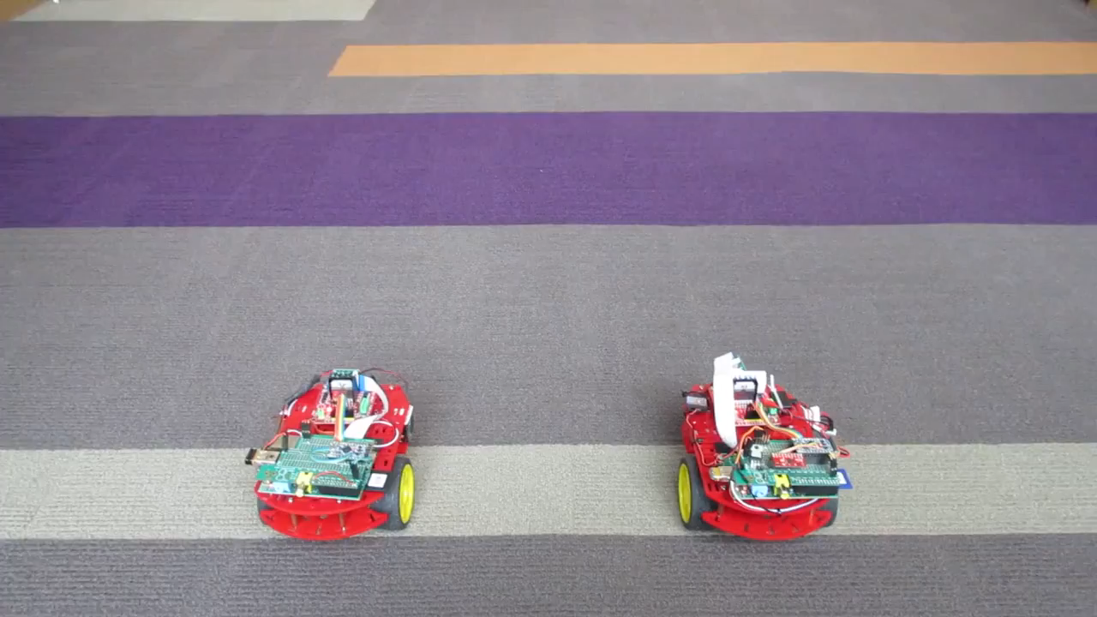
Dancing Robots

Slide 23
Thanks!
To Ryan Lemmer for comments on my FnConf’14 talk, which helped transform it to what became the Google Talk on APL: https://www.youtube.com/watch?v=PlM9BXfu7UY

